Slide 1
MySQL
MySQL SQL

Slide 2

MySQL SQL
What is SQL?
SQL is the standard language for dealing with Relational Databases.
SQL is used to insert, search, update, and delete database records.
How to Use SQL
The following SQL statement selects all the records in the "Customers" table:

Slide 3
MySQL SQL
SQL keywords are NOT case sensitive: select is the same as SELECT
Some database systems require a semicolon at the end of each SQL statement.
Semicolon is the standard way to separate each SQL statement in database systems that allow more than one SQL statement to be executed in the same call to the server.

Slide 4
MySQL SQL
Some of The Most Important SQL Commands:
SELECT - extracts data from a database
UPDATE - updates data in a database
DELETE - deletes data from a database
INSERT INTO - inserts new data into a database
CREATE DATABASE - creates a new database

Slide 5
MySQL SQL
Some of The Most Important SQL Commands:
ALTER DATABASE - modifies a database
CREATE TABLE - creates a new table
ALTER TABLE - modifies a table
DROP TABLE - deletes a table
CREATE INDEX - creates an index (search key)
DROP INDEX - deletes an index

Slide 6


MySQL SELECT Statement
SELECT Syntax
Here, column1, column2, ... are the field names of the table you want to select data from.
If you want to select all the fields available in the table, use the following syntax:

Slide 7
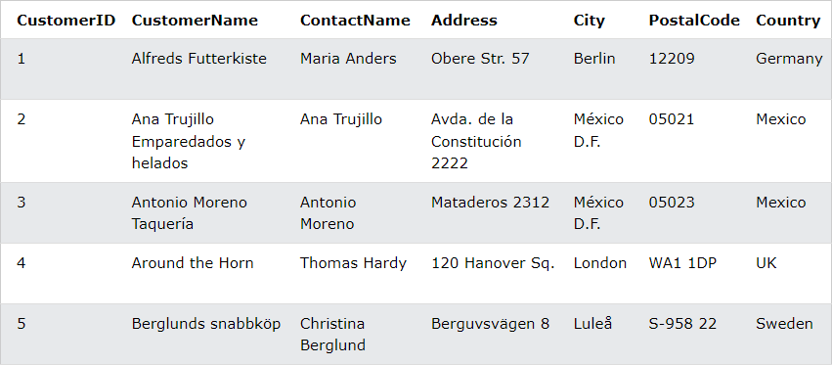
MySQL SELECT Statement
Demo Database
Below is a selection from the "Customers" table in the Northwind sample database:

Slide 8

MySQL SELECT Statement
SELECT Columns Example
The following SQL statement selects the "CustomerName", "City", and "Country" columns from the "Customers" table:
SELECT * Example
The following SQL statement selects ALL the columns from the "Customers" table:

Slide 9

MySQL SELECT Statement
The MySQL SELECT DISTINCT Statement
The SELECT DISTINCT statement is used to return only distinct (different) values.
Inside a table, a column often contains many duplicate values; and sometimes you only want to list the different (distinct) values.
SELECT DISTINCT Syntax

Slide 10

MySQL SELECT Statement
SELECT Example Without DISTINCT
The following SQL statement selects all (including the duplicates) values from the "Country" column in the "Customers" table:
Now, let us use the SELECT DISTINCT statement and see the result.

Slide 11

MySQL SELECT Statement
SELECT DISTINCT Examples
The following SQL statement selects only the DISTINCT values from the "Country" column in the "Customers" table:
The following SQL statement counts and returns the number of different (distinct) countries in the "Customers" table:

Slide 12

MySQL WHERE Clause
The MySQL WHERE Clause
The WHERE clause is used to filter records.
It is used to extract only those records that fulfill a specified condition.
WHERE Syntax

Slide 13
MySQL WHERE Clause

Slide 14
MySQL WHERE Clause
Demo Database
Below is a selection from the "Customers" table in the Northwind sample database:

Slide 15

MySQL WHERE Clause
WHERE Clause Example
The following SQL statement selects all the customers from "Mexico":
Text Fields vs. Numeric Fields
SQL requires single quotes around text values (most database systems will also allow double quotes).
However, numeric fields should not be enclosed in quotes:

Slide 16
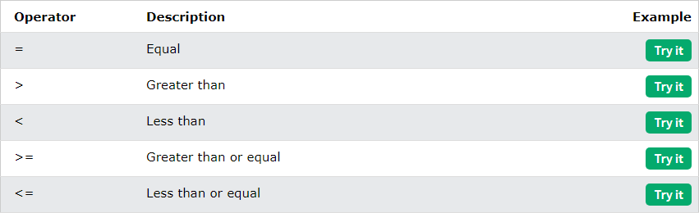
MySQL WHERE Clause
Operators in The WHERE Clause
The following operators can be used in the WHERE clause:

Slide 17
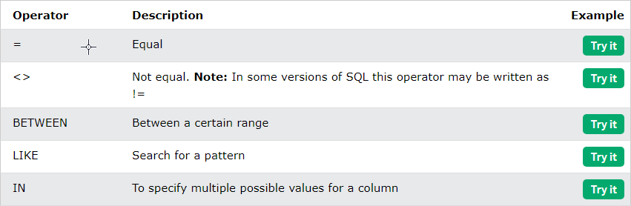
MySQL WHERE Clause
Operators in The WHERE Clause
The following operators can be used in the WHERE clause:

Slide 18
MySQL AND, OR and NOT Operators
The MySQL AND, OR and NOT Operators
The WHERE clause can be combined with AND, OR, and NOT operators.
The AND and OR operators are used to filter records based on more than one condition:
The AND operator displays a record if all the conditions separated by AND are TRUE.
The OR operator displays a record if any of the conditions separated by OR is TRUE.
The NOT operator displays a record if the condition(s) is NOT TRUE.

Slide 19


MySQL AND, OR and NOT Operators
AND Syntax
OR Syntax

Slide 20

MySQL AND, OR and NOT Operators
NOT Syntax

Slide 21
MySQL AND, OR and NOT Operators
Demo Database
Below is a selection from the "Customers" table in the Northwind sample database:

Slide 22


MySQL AND, OR and NOT Operators
AND Example
The following SQL statement selects all fields from "Customers" where country is "Germany" AND city is "Berlin":
OR Example
The following SQL statement selects all fields from "Customers" where city is "Berlin" OR "Stuttgart":

Slide 23


MySQL AND, OR and NOT Operators
OR Example
The following SQL statement selects all fields from "Customers" where country is "Germany" OR "Spain":
NOT Example
The following SQL statement selects all fields from "Customers" where country is NOT "Germany":

Slide 24

MySQL AND, OR and NOT Operators
Combining AND, OR and NOT
You can also combine the AND, OR and NOT operators.
The following SQL statement selects all fields from "Customers" where country is "Germany" AND city must be "Berlin" OR "Stuttgart" (use parenthesis to form complex expressions):

Slide 25

MySQL AND, OR and NOT Operators
Combining AND, OR and NOT
The following SQL statement selects all fields from "Customers" where country is NOT "Germany" and NOT "USA":

Slide 26

MySQL ORDER BY Keyword
The MySQL ORDER BY Keyword
The ORDER BY keyword is used to sort the result-set in ascending or descending order.
The ORDER BY keyword sorts the records in ascending order by default. To sort the records in descending order, use the DESC keyword.
ORDER BY Syntax

Slide 27
MySQL ORDER BY Keyword
Demo Database
Below is a selection from the "Customers" table in the Northwind sample database:

Slide 28

MySQL ORDER BY Keyword
ORDER BY Example
The following SQL statement selects all customers from the "Customers" table, sorted by the "Country" column:

Slide 29

MySQL ORDER BY Keyword
ORDER BY DESC Example
The following SQL statement selects all customers from the "Customers" table, sorted DESCENDING by the "Country" column:

Slide 30

MySQL ORDER BY Keyword
ORDER BY Several Columns Example
The following SQL statement selects all customers from the "Customers" table, sorted by the "Country" and the "CustomerName" column. This means that it orders by Country, but if some rows have the same Country, it orders them by CustomerName:

Slide 31

MySQL ORDER BY Keyword
ORDER BY Several Columns Example 2
The following SQL statement selects all customers from the "Customers" table, sorted ascending by the "Country" and descending by the "CustomerName" column:

